Slide 1


Military Intelligence Part II
John Beverley
Assistant Professor, University at Buffalo
Co-Director, National Center for Ontological Research
Affiliate Faculty, Institute of Artificial Intelligence and Data Science

Slide 2
Outline
Modern Warfare
Coordination by Standardization
Coordination by Ontologies as Standardization

Slide 3
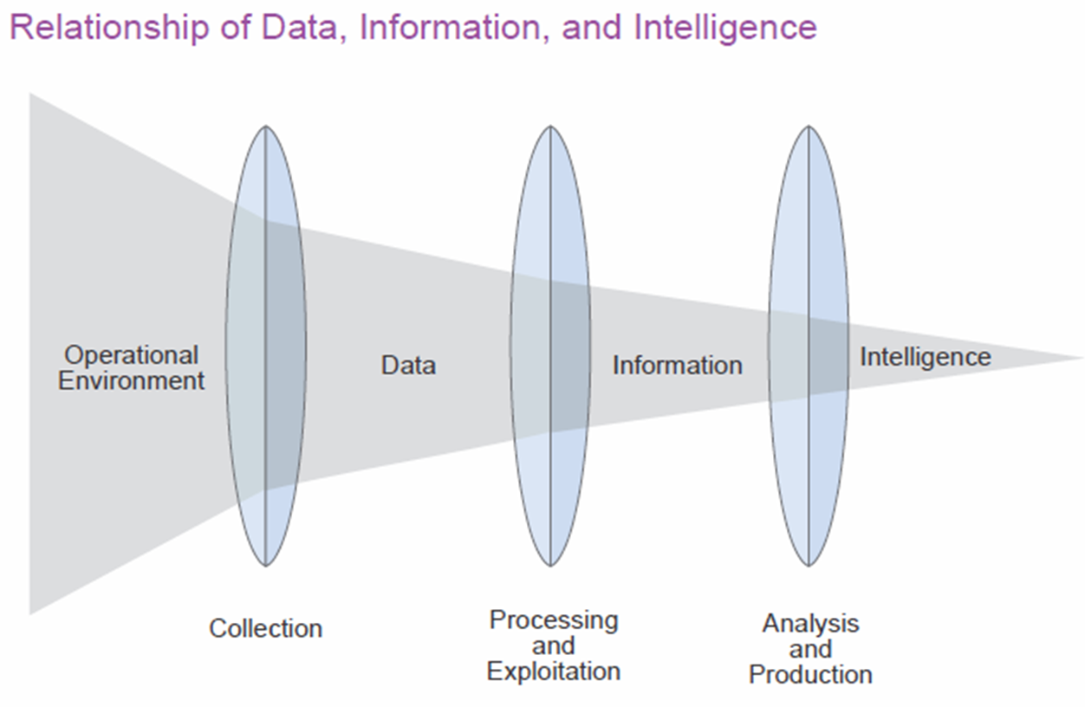
Anticipating Massing Intelligence Fires
Integrating data from operational perspective requires automation
Prediction requires:
Real-time information sharing and revising
Common operational perspective
Interoperability across activities
Which will require:
New information support strategies
Semantic interoperability across data
New governance and training for both humans and machines

Slide 4
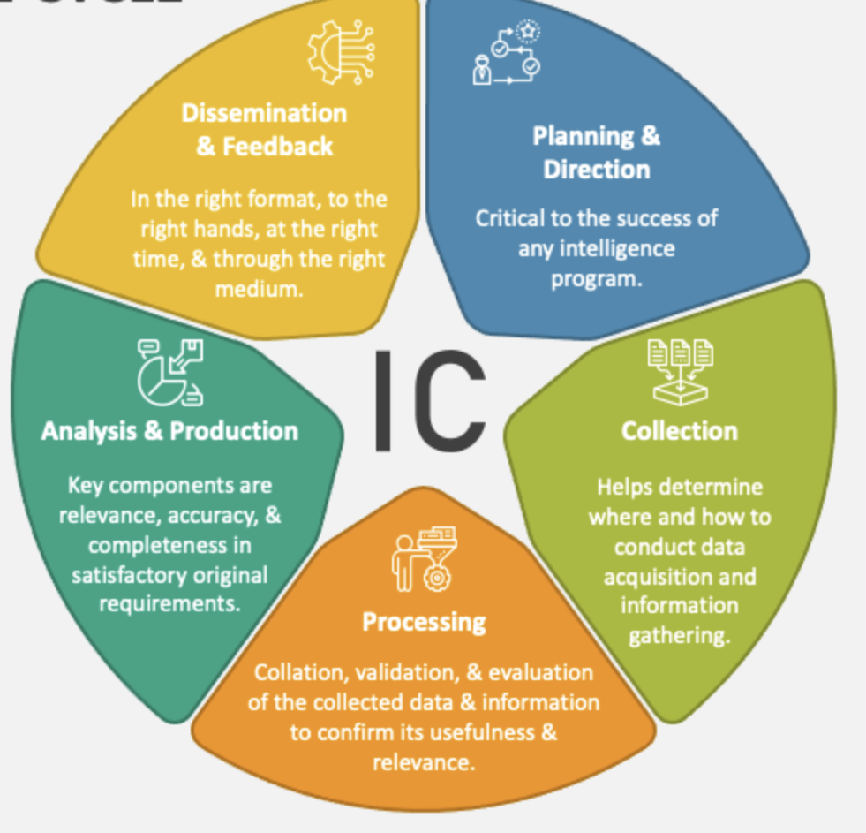
Anticipating Massing Intelligence Fires
Integrating data from operational perspective requires automation
Prediction requires:
Real-time information sharing and revising
Common operational perspective
Interoperability across activities
Which will require:
New information support strategies
Semantic interoperability across data
New governance and training for both humans and machines

Slide 5



Strategy 1: Semantic Waterfall
The favored solution among government agencies to solving interoperability problems is the Waterfall Model:
Must be built en bloc before deployment
Inflexible, unresponsive to mission needs
Heavy, error-prone, manual effort for construction and ingestion
Offers limited analytic capability
Has a limited lifespan because it rests on one point of view

Slide 6
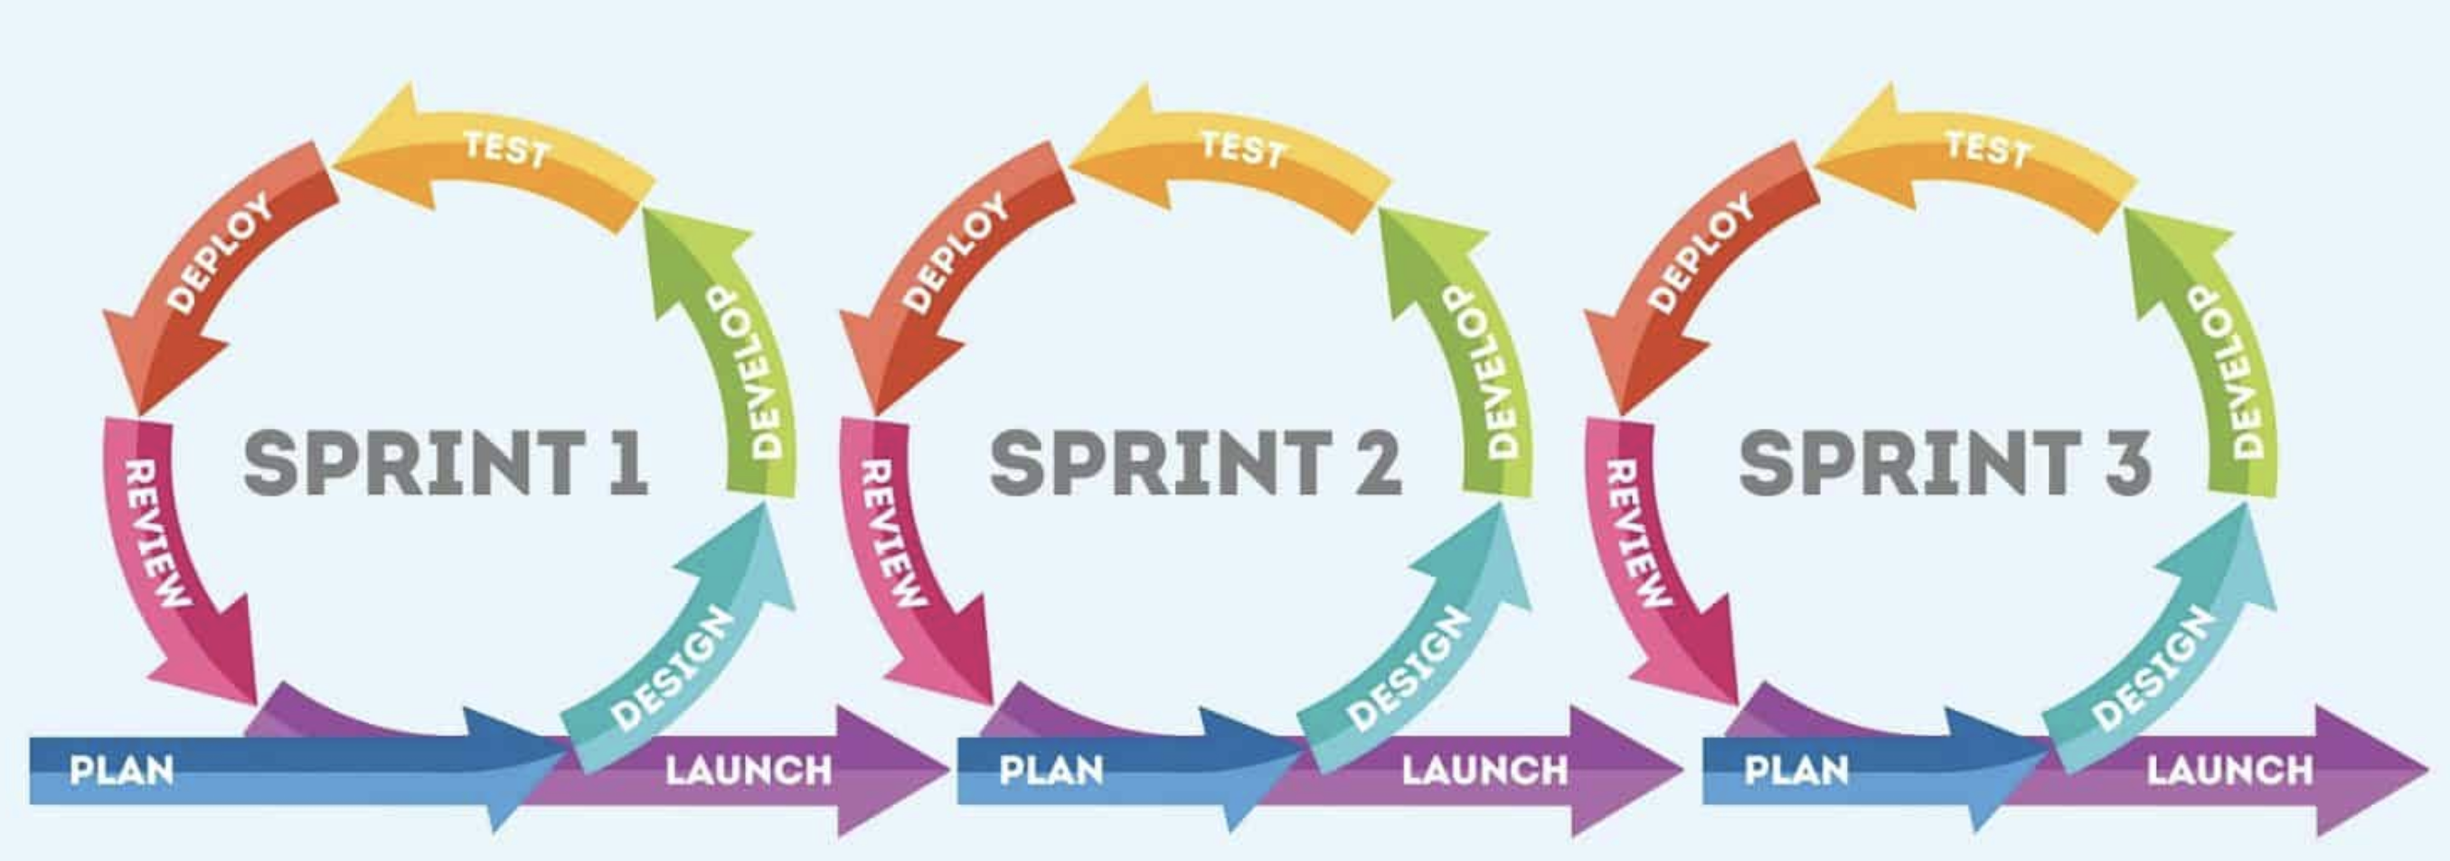
Strategy 2: Agile Semantics
Build ontologies at the speed of mission following the middle-in strategy
Data remains unchanged:
But is ‘tagged’ using interoperable ontologies
Allowing flexible response to new needs and adjustments in real time
Can be as complete as needed
Importantly, this strategy works only to the degree that it rests on shared governance and training

Slide 7

Strategy 2: Agile Semantics
Build ontologies at the speed of mission following the middle-in strategy
Data remains unchanged:
But is ‘tagged’ using interoperable ontologies
Allowing flexible response to new needs and adjustments in real time
Can be as complete as needed
Importantly, this strategy works only to the degree that it rests on shared governance and training

Slide 8
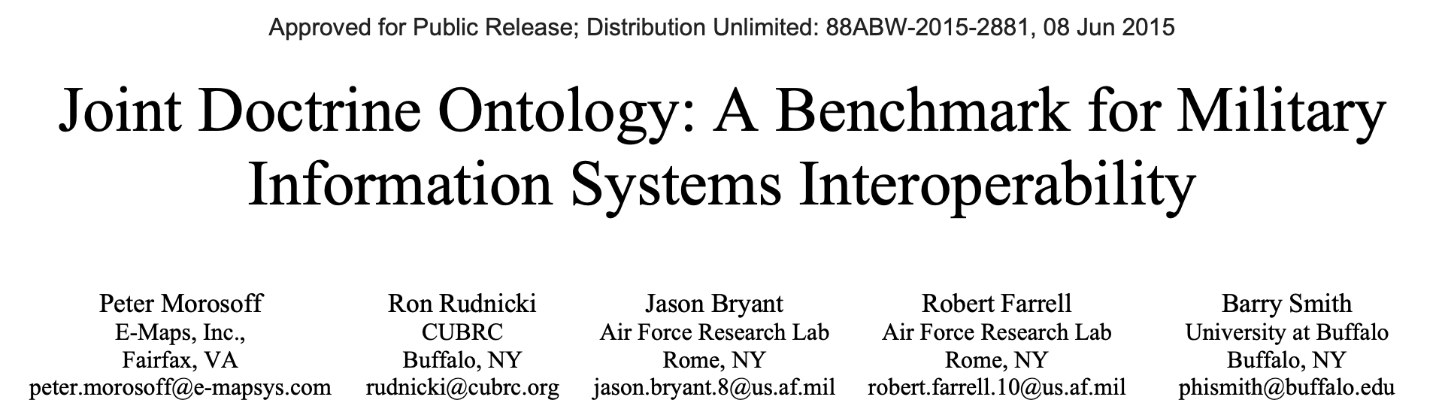
Strategy 2: Agile Semantics
Build ontologies at the speed of mission following the middle-in strategy
Data remains unchanged:
But is ‘tagged’ using interoperable ontologies
Allowing flexible response to new needs and adjustments in real time
Can be as complete as needed
Importantly, this strategy works only to the degree that it rests on shared governance and training

Slide 9
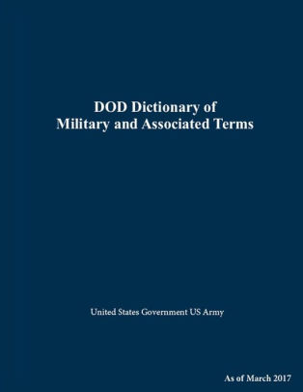
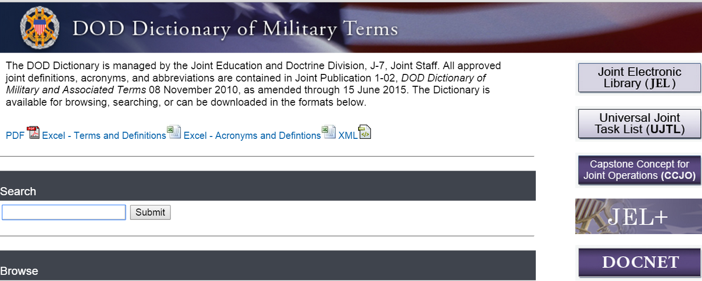
Joint Doctrine Ontology Project
Create a computational counterpart of the DOD Dictionary of Military and Associated Terms
Test in Air Force Research Lab (AFRL) to support joint operations
To promote Joint Doctrine terminology across DOD to advance interoperability

Slide 10
Motivation
Enable the identification of logical issues in the DOD Dictionary and Joint Doctrine Publications
Facilitate coordination of training and operations
Increase automation of plans, ops assessment, BlueForce Status, etc.
Allow novel assessment processes based on measures of adherence to doctrine, which may give rise to new ways of computationally identifying areas where changes in doctrine may be needed

Slide 11
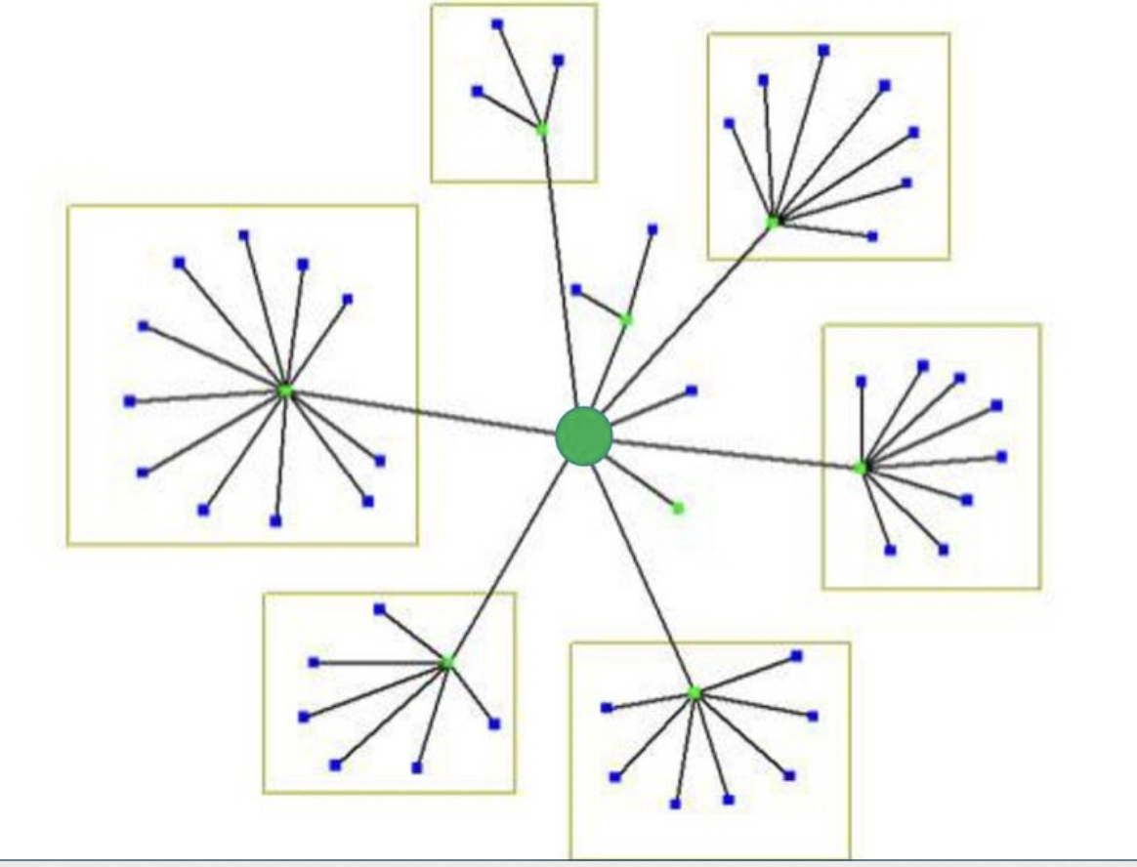
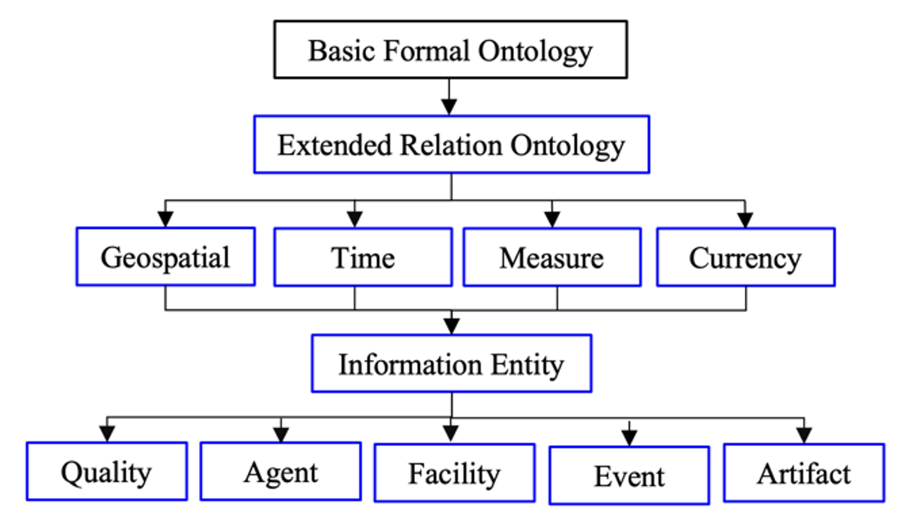
BFO and CCO
Leverage vetted, widely-used open-source standards
Leverage downward population strategy starting with the Basic Formal Ontology down into the Common Core Ontologies mid-level suite

Slide 12
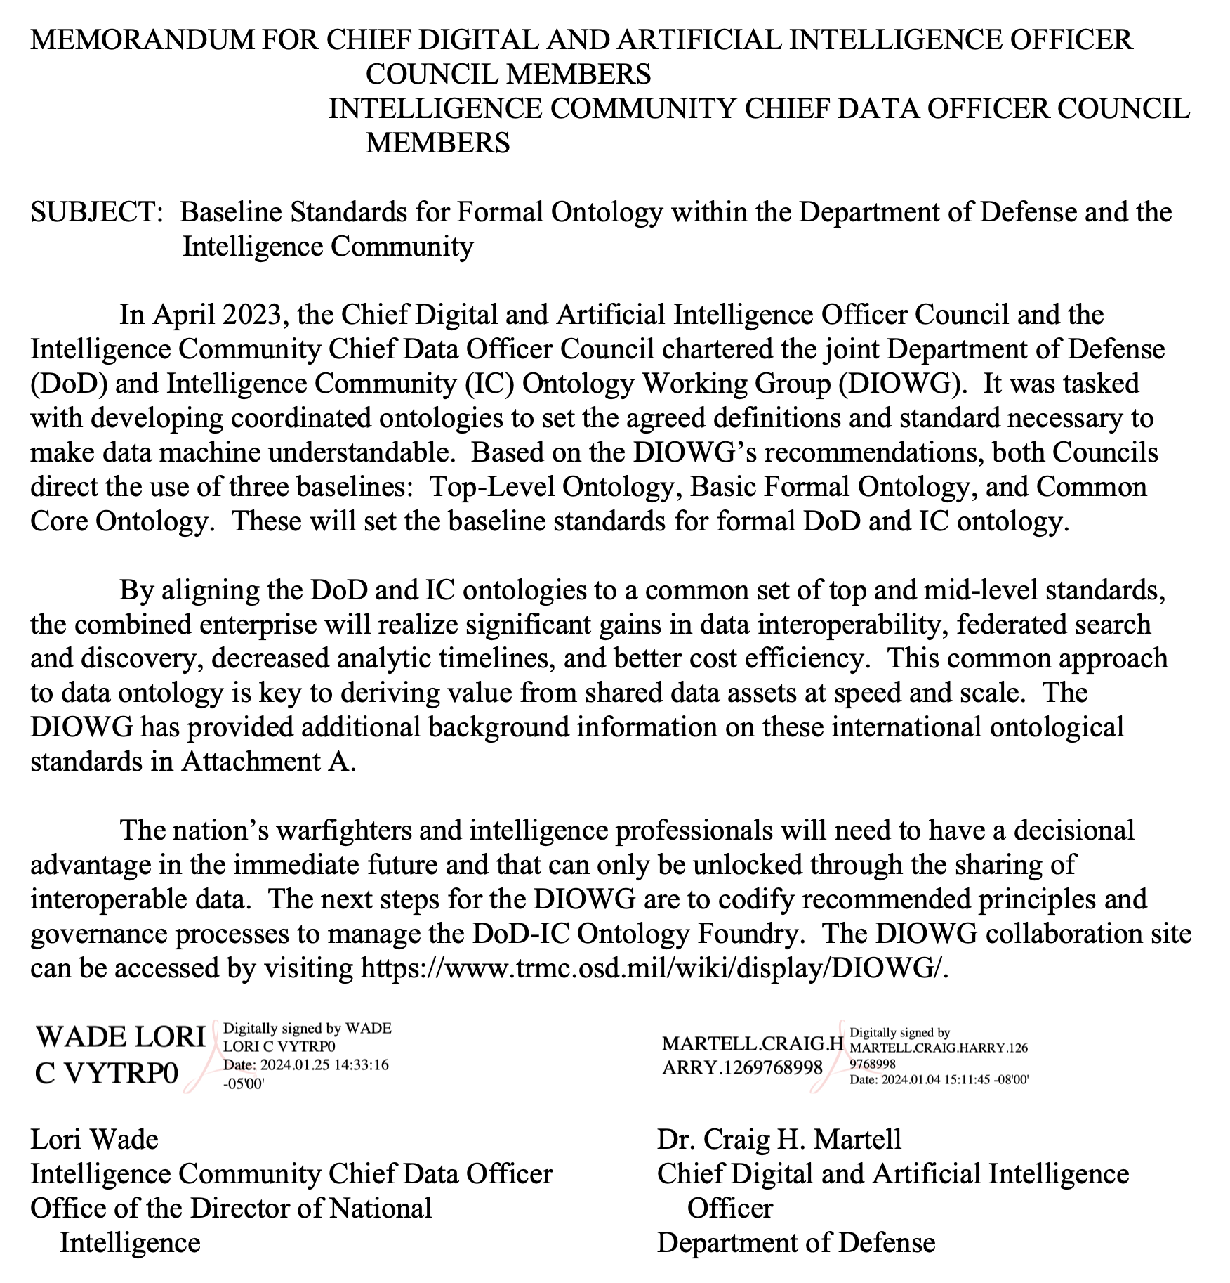
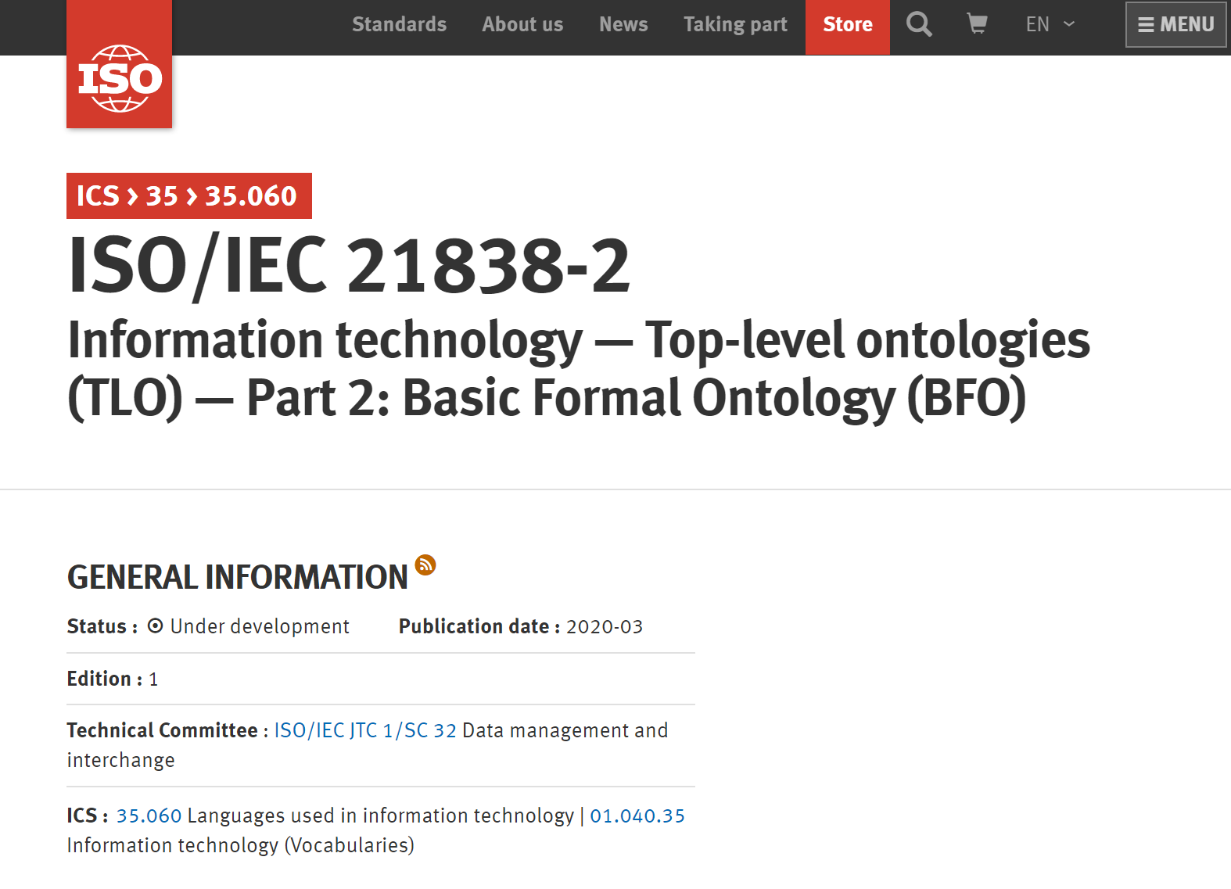

Slide 13
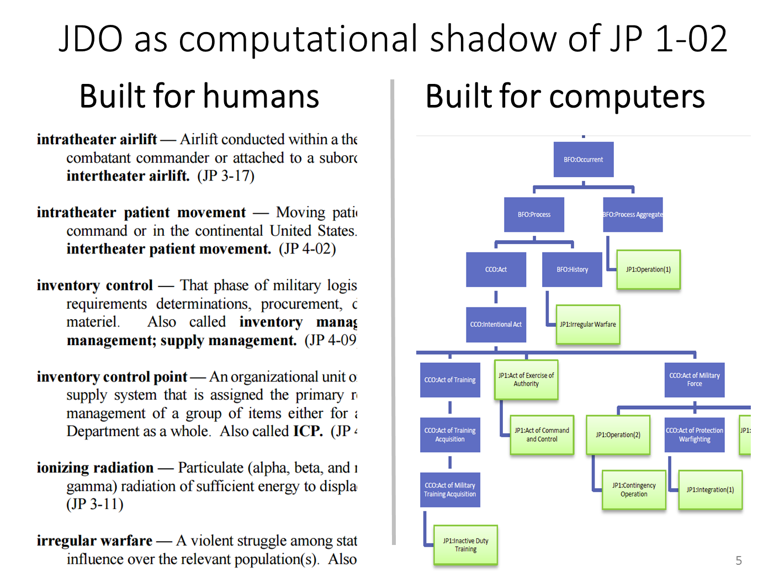
Joint Doctrine Ontology
To create a computational counterpart of the DOD Dictionary of Military and Associated Terms

Slide 14
DOD Dictionary Issues
To create a computational counterpart of the DOD Dictionary of Military and Associated Terms

Slide 15
DOD Dictionary Issues
Despite the breadth of coverage, the DOD Dictionary does not provide definitions for common military terms:
Commander
Geographic Area
Geopolitical Entity
Nation
National Organization
Organization
Territory
Training

Slide 16
Group Exercise
Gather into groups and reflect on the definitions provided from the DOD Dictionary
Keep the lesson I’ve been pressing in mind regarding the purpose of crafting definitions
Be prepared to defend and revise your definitions

Slide 17

Moving from the words we use to the world we inhabit, is unlikely to lead us to the same destination

Slide 18
Joint Doctrine Ontology Issues
Current guidelines for supplementing missing definitions is to check Webster’s Dictionary...
Questions immediately arise:
Which edition?
Which of the multiple definitions typically provided for each term?
How should address inconsistency between Webster’s and existing DOD definitions?

Slide 19

Missing from Both DOD & Webster’s
Level of War
Situational awareness
Mission Assurance from Situational Awarenes
Cyber Situational Awareness Explorer
Network Command and Control Integrated Situation Awareness Capability

Slide 20
Group Exercise
Gather into groups and attempt to provide a single definition for each of these missing terms; you are welcome to use online resources
Level of War
Situational awareness
If you find multiple definitions online, be sure to report that information to the class

Slide 21
Moving from the words we use to the world we inhabit, is unlikely to lead us to the same destination

Slide 22
Ontology Solutions
You should be able to see – and indeed have been able to demonstrate - how ontological strategies can address definitional issues
Leveraging top- and mid-level standards should support optimism about such a project
There are, however, deeper challenges ahead

Slide 23
Challenge 1: Military Ontology
An adequate account of military entities will require at a minumum ontological characterizations of:
Social dispositions, e.g. military customs, jargon, conventions, etc.
Speech acts, e.g. imperatives, interrogatives, credence, etc.
Mental functioning, e.g. beliefs, knowledge, intentionality, etc.
Social acts, e.g. intelligence gathering, coordinated tactics, etc.
Documents, e.g. rankings, intelligence reports, drill manuals, etc.
Authorities, e.g. agencies, squad leads, subject-matter experts, etc.
Digital, e.g. encryption, sensor communication, etc.
Hardware, e.g. weapons, facilities, towers, etc.

Slide 24
Challenge 1: Military Ontology
An adequate account of military entities will require at a minumum ontological characterizations of:
Social dispositions, e.g. military customs, jargon, conventions, etc.
Speech acts, e.g. imperatives, interrogatives, credence, etc. (ARGO)
Mental functioning, e.g. beliefs, knowledge, intentionality, etc. (MFO)
Social acts, e.g. intelligence gathering, coordinated tactics, etc.
Documents, e.g. rankings, intelligence reports, drill manuals, etc. (D-ACTS/RANKS)
Authorities, e.g. agencies, squad leads, subject-matter experts, etc. (CCO)
Digital, e.g. encryption, sensor communication, etc. (CCO-Cyber)
Hardware, e.g. weapons, facilities, towers, etc. (CCO)
green indicates developed work; blue indicates first steps; red indicates gap

Slide 25
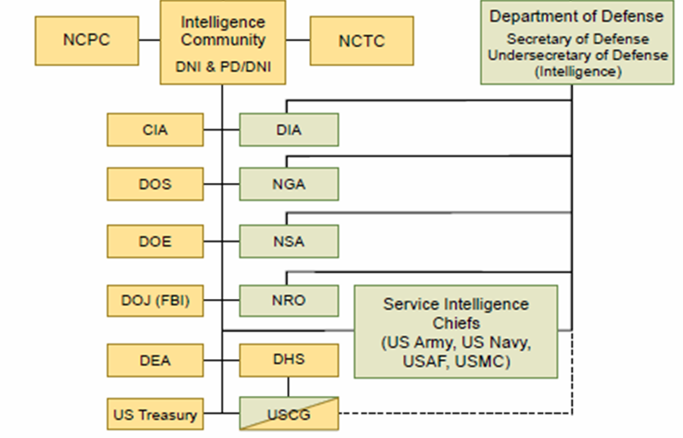
Challenge 2: “Three-Letter Suite”
Various agencies will create controlled vocabulary of the terms commonly used in its domain; various ontologies will then be created
Just as the Gene Ontology spurred a proliferation of uncoordinated ontologies, we should expect success to bring similar fruits
Every agency wants to have its own “three-letter ontology suite”

Slide 26
Readings
Joint Doctrine Ontology
Complexity in Military Intelligence

